Slide 1
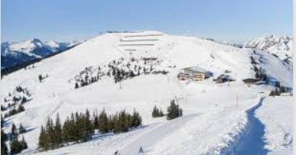
Big Mountain Resort
Pricing Strategy
Recommendation
02/15/2021
Moon Chu

Slide 2
Current Issue
1
Current Issue
Big Mountain Resort has recently installed an additional chair lift to help increase the distribution of visitors and this additional chair increases their operating costs by $1,540,000 this season. They are charging a premium above the average price in the market but there's a suspicion that Big Mountain is not capitalizing on its facilities
2
Criteria for success
1) Being able to come up with a strategy on selecting a better value for their ticket price
.
2) Suggestion on a number of changes that they hope will either cut costs without undermining the ticket price or will support an even higher ticket price.
3
Project Scope
Ticket pricing strategy, cost cutting strategy without undermining the ticket price

Slide 3
Recommendation and key findings
H
1
Key Findings
Big Mountains facility is located at the very high end of various facilities in the market. However, there are still rooms to improve the revenue by price increase.
Throughout this modeling exercise we ran linear model and random forest model (detail in slide 6,7) and we identified that run closure, increase vertical drop and installing chair lift supports price increase and additional revenue.
2
Recommendation
At this point we only know the cost of the additional chair installation and no information was given for the rest of other variables. We can connect the dots by getting full cost information and based on this, Big Mountain will be able to come up with a profit maximization model.

Slide 4
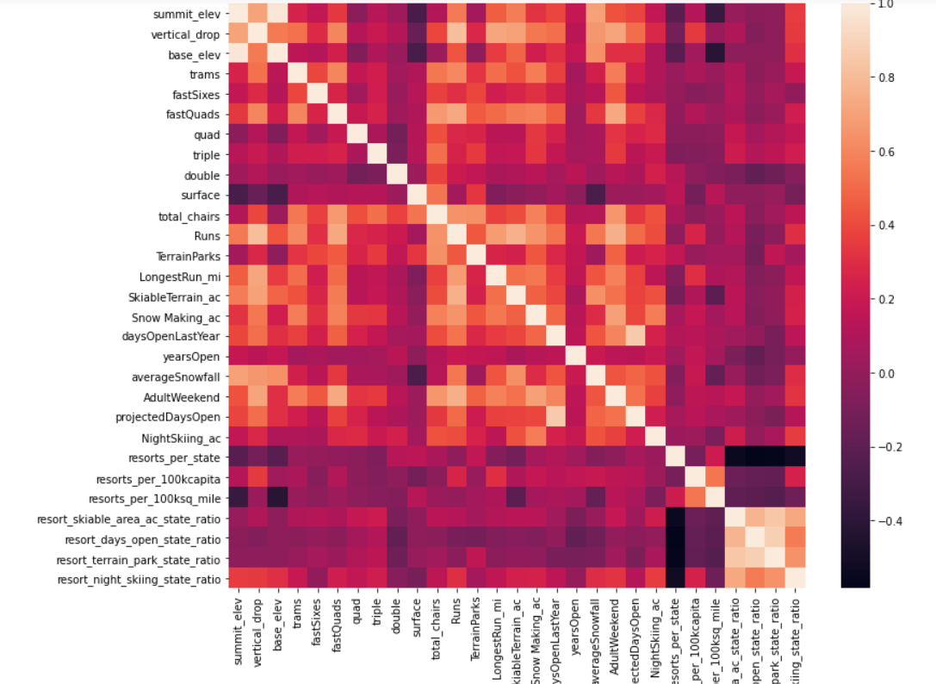
Modeling results and analysis – Descriptive Statistics
H
1
Statewide Ski Report Market Landscape :
Montana is the 3rd largest states in U.S and has 4th largest total skiable area but the population doesn’t belong to top 5 most populated states in U.S. In other words, there are states that host many resorts, but other states host a larger total skiing area. In terms of resort per 100k capita ration, Montana is 4th largest states with 1.12, meaning Montana has about 1 resort per 100K capita.
AdultWeekend ticket price has quite a few reasonable correlations. fastQuads stands out, along with Runs and Snow Making_ac. Visitors would seem to value more guaranteed snow, which would cost in terms of snow making equipment, which would drive prices and costs up. Of the new features, resort_night_skiing_state_ratio seems the most correlated with ticket price. If this is true, then perhaps seizing a greater share of night skiing capacity is positive for the price a resort can charge.
As well as Runs, total_chairs is quite well correlated with ticket price. This is plausible; the more runs you have, the more chairs you'd need to ferry people to them!

Slide 5
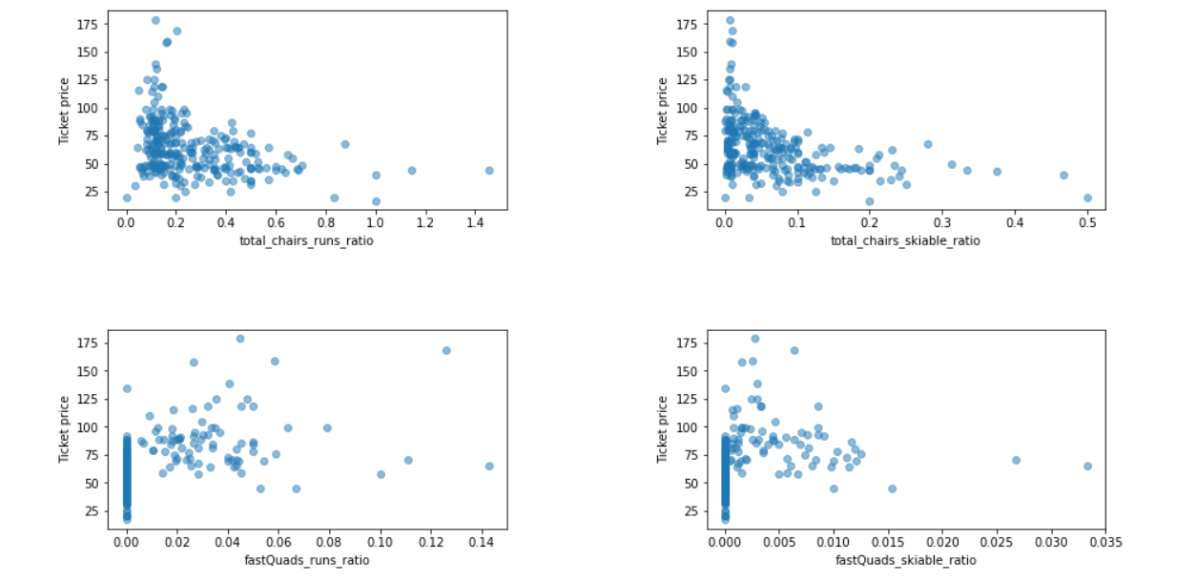
Modeling results and analysis – Descriptive Statistics
H
1
Statewide Ski Report Market Landscape :
It seems that the more chairs a resort has to move people around, relative to the number of runs, ticket price rapidly plummets and stays low. What we may be seeing here is an exclusive vs. mass market resort effect; if you don't have so many chairs, you can charge more for your tickets, although with fewer chairs you're inevitably going to be able to serve fewer visitors. Your price per visitor is high but your number of visitors may be low. Something very useful that's missing from the data is the number of visitors per year.
It also appears that having no fast quads may limit the ticket price, but if your resort covers a wide area then getting a small number of fast quads may be beneficial to ticket price.

Slide 6
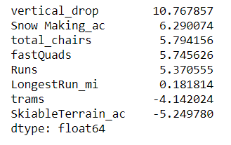
Modeling results and analysis
1
Linear Model
Process : Split the existing data with train and test set and keep shuffling the data (cross validation) k times to make sure the model performs well on unseen data but without having to touch the test set.
Then what features were most useful?
These results suggest that vertical drop is the biggest positive feature. This makes intuitive sense and is consistent with what you saw during the EDA work. Also, the area covered by snow making equipment is a strong positive as well. One thing to note is that the coefficient for skiable terrain is negative for this model. For example, if you kept the total number of chairs and fastQuads constant, but increased the skiable terrain extent, you might imagine the resort is worse off because the chairlift capacity is stretched thinner.

Slide 7
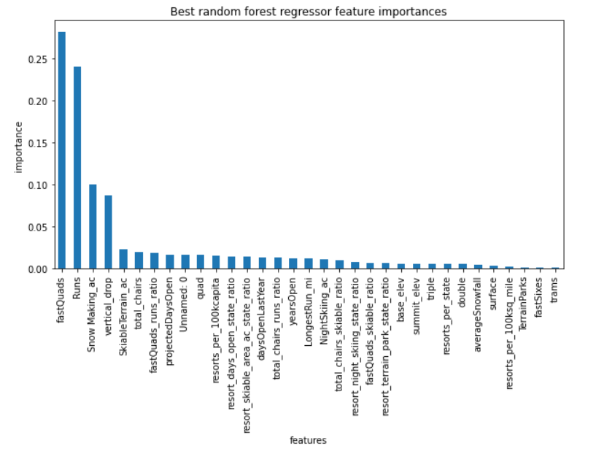

Modeling results and analysis
2
Random Forest Model
Encouragingly, the dominant top four features are in common with your linear model:
fastQuads
Runs
Snow Making_ac
vertical_drop
3
The random forest model has a lower cross-validation mean absolute error by almost $1. It also exhibits less variability. Verifying performance on the test set produces performance consistent with the cross-validation results.
Model Selection

Slide 8
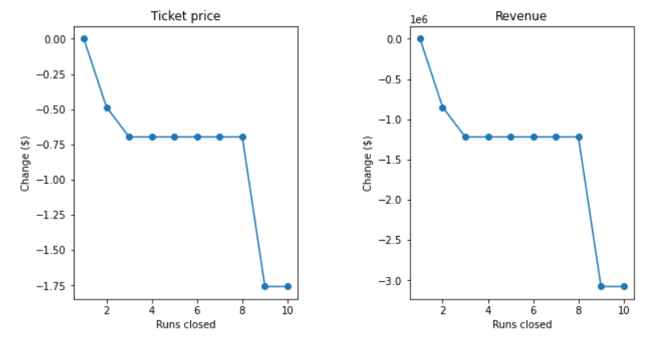
Modeling Scenarios
1
Permanently closing down up to 10 of the least used runs
Closing one run makes no difference. Closing 2 and 3 successively reduces support for ticket price and so revenue
2
Adding a run, increasing the vertical drop by 150 feet, and installing an additional chair lift.
This scenario increases support for ticket price by $5.52 Over the season, this could be expected to amount to $9651515
3
Increase the longest run by 0.2 mile to boast 3.5 miles length, requiring an additional snow making coverage of 4 acres
No difference

Slide 9
Summary and conclusion
1
Summary
By reviewing multiple scenarios, it was found out that two scenarios out of four that we reviewed makes difference. 1) Closing the run or 2) Adding a run, increasing the vertical drop by 150 feet, and installing an additional chair lift.
- Closing the run will improve the operating cost and there are large revenue drops after 8 run closure so we would need careful approach to close the run.
- As for the second scenario, adding 1 additional chair doesn’t support price increase, but adding 2 chairs will support ticket price increase by $2.06 and it will bring $3.6 million. Also adding 3 chairs will support price increase by $5 dollar and bring $9.6 million additional revenue. However, we can only add chairs when the increase revenue will well cover the additional operating cost. One additional chair increase cost $1.54 million per season. However, we already know that adding 1 chair won't do anything and we will start to see the increase of the revenue of 3.6 million, in case of two chairs that cost 3.08 million. 3 chairs will bring $9.6 million but it will cost $4.5 million of operating cost. So do we just want to increase the number of chairs? Probably not. Big mountain is already high end of number of chair distribution and we would need more comprehensive strategies.
2
Recommendation and next steps
Not we know the important features that supports price increase and expected revenue increase. However we still have a gap that we do not know all the cost related to this except that we know of operating cost of additional chair increase.
As a next step, it is recommended to find out the operating cost of adding a run and increasing vertical drop as well so we can come up with a formula that maximize the profit.

Slide 10
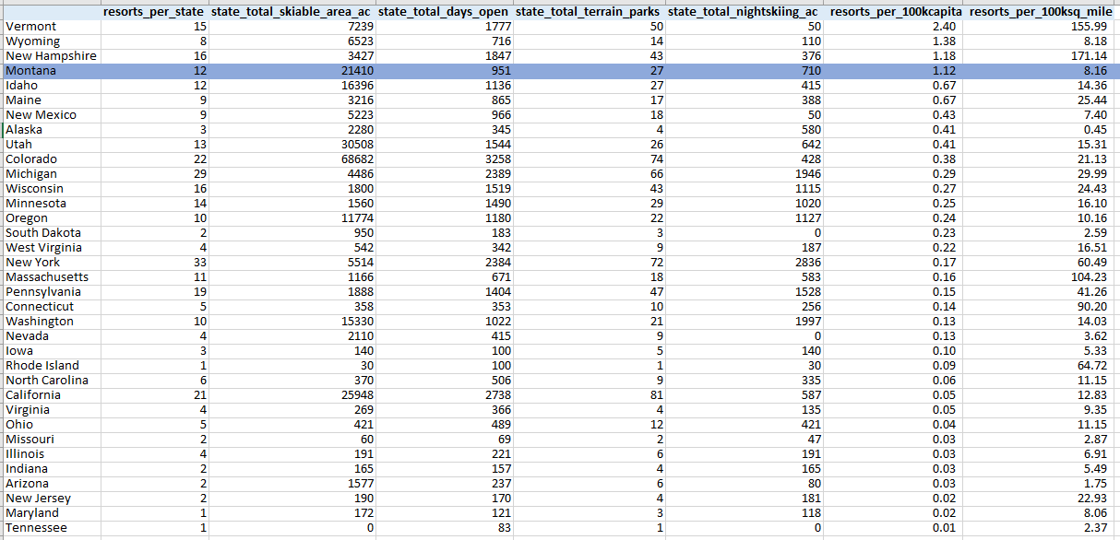
Appendix
Ski market Competitive Landscape

